Slide 1
Process Controls SAP Part Entry
4/15/25

Slide 2
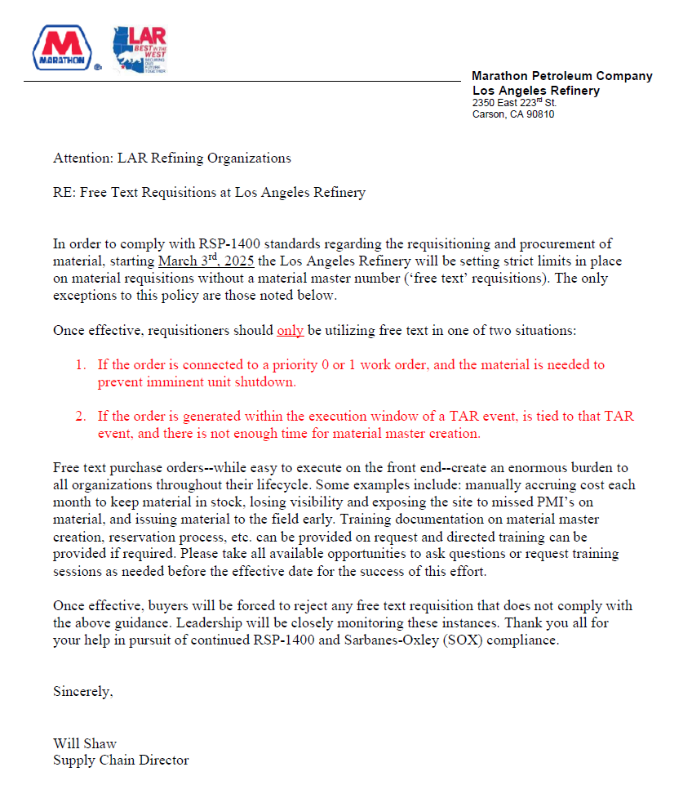
Background @ LAR
Starting 3/3/25 (RSP-1400)
No FFT (Free Form Text) Reqs barring 2 exceptions (Priority 0 or 1 WO#, TAR)
No Part Purchase Requisitions without MM#
Training can be provided on request (No Training Given)

Slide 3
LAR Part Purchase Process (Before)
Need Part
Request Quote From Vendor
Create PR (Purchase Req)
Generate PO
Receive Part
Supply Chain
PCG
PCG
PCG
Warehouse
3 -14 Days
1 - 3 Days
+ Part Lead Time

Slide 4
LAR Part Purchase Process (Now)
Need Part
Request Quote From Vendor
Cross Check SAP
Create New MM# or Extend MM#
Create PR
Generate PO
Receive Part
SAP Fiori
Supply Chain
PCG
PCG
PCG
PCG
Warehouse
3 -14 Days
0-3 Days
5-7 Days
1 - 3 Days
+ Part Lead Time
Added 6-10 Days into the Process with onus on PCG to follow-up

Slide 5
SAP Quality Concerns
Current SAP has been populated by various sites
Multiple SAP MM# for same mfg part #
Universal I/O Module [CC-PUIO31] has two MM# (20220099, 3867569)
C300 [CC-PCNT02] has three MM# (38981203,100080205, 38000727)
This is not a unique situation and often occurs as each site inputs their own SAP MM# requests to add “new” MM#s into the system.

Slide 6
Potential Issues #1
LAR can move forward and just pick one of the MM#s available whenever we need to and create new MM#s for the parts not currently in SAP.
It is likely other refineries will also be doing the same actions. Depending on how thoroughly the person researches what is currently available in SAP, this may exacerbate the issue with additional SAP MM# creation for the same manufacturer part #.
Someone could pick one MM# to use (for example just use 38000727 for CCPCNT02) and delete the others. However, this will cause rework for any of the sites that had been previously been using the other MM# (38981203 and 100080205). They will have to re-link their site to use that number (38000727).

Slide 7
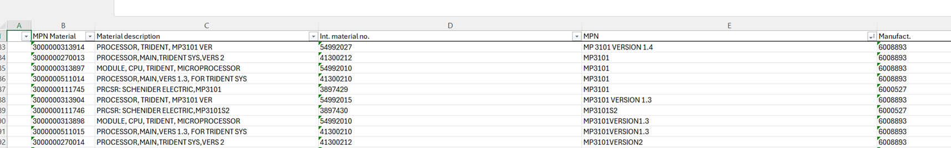
Potential Issues #2
Often times, the hardware/firmware/revision of a specific card or processor can be important. In the pictured example, a Trident Main Processor 3101 looks to have 5 or 6 different SAP MM#s. Someone had decided that the firmware with which the 3101 was flashed needed to be included and have unique MM#s. This is true as Schneider is currently the only one that flashes MP3101 and does not allow sites to flash it ourselves.

Slide 8
Work Process (Phase 1)
Document Existing MM# and Part #s in SAP
Collect, Aggregate, and Compare Existing Hardware BOMs to SAP
MM# Review and Refinement
Identify MM# to be Used for Existing
Identify Missing Equipment from MM# Listing
Submit Requests for MM# Creation
Submit Requests for MM# Linking to Refinery
Do we need Quotes for Everything???

Slide 9
Work Process (Phase 2)
Build Out Equipment BOM in SAP per Functional Location
Establish PM02 (Preventative Maintenance) Procedures to Functional Locations
Establish Stocking Levels in Warehouse
Warehouse Parts Organization
SAP Training
Hardware vs Firmware vs Software vs Version Segregation

Slide 10
CAG Questions
How are other sites planning to tackle this effort? Are you planning to use your current resources?
What is the end goal for Process Controls Equipment? Phase 1? Phase 2? Phase 2+ (Inventory across refineries, etc.)
If the request is to use Supply Chain to do much of this work, how are we going to validate the quality? Sometimes, the hardware/firmware/revision of a specific piece is critically important.
Side question: All Software/Computer purchases are supposed to now go through IT tickets, Asset Management, etc. Are all sites doing this way as well? Software does not currently require MM# if done through IT tickets. [EULA requests, Non-Catalog Software Ticket]

Slide 12
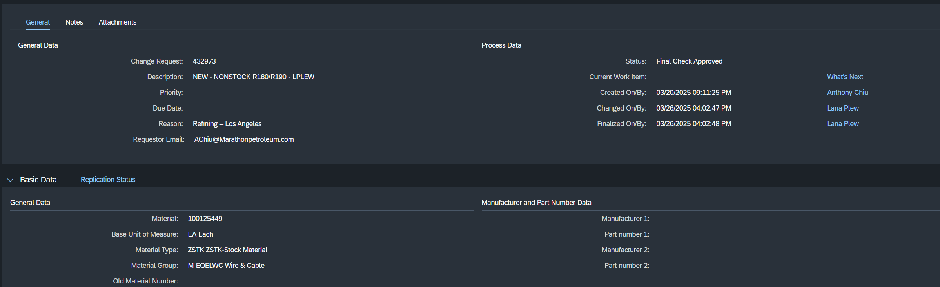
SAP Fiori Example
Experion IO Link Cable

